Slide 1

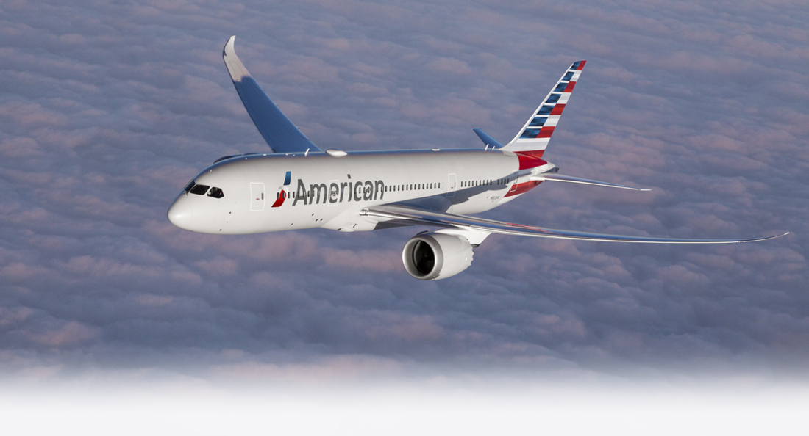

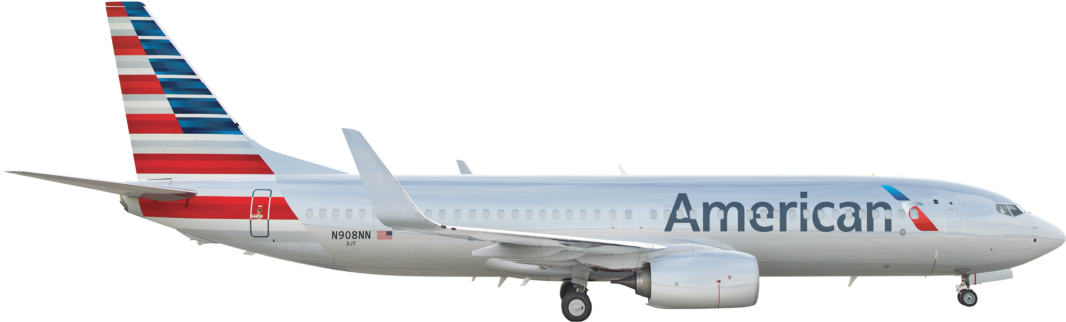
American Airlines Tweets Sentiment Analysis

Slide 2

Presentation Layout
Introduction
Project objectives
Data Exploration
The model
conclusion
Weak Points and Shortcomings

Slide 3
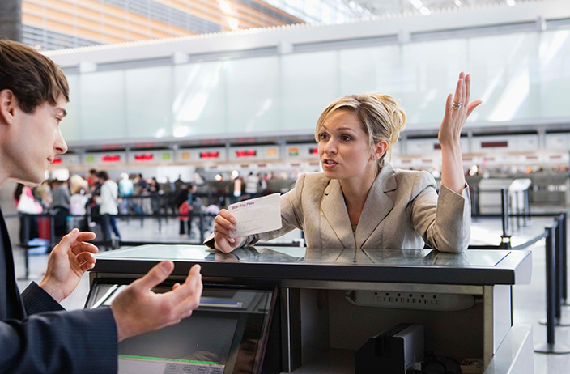
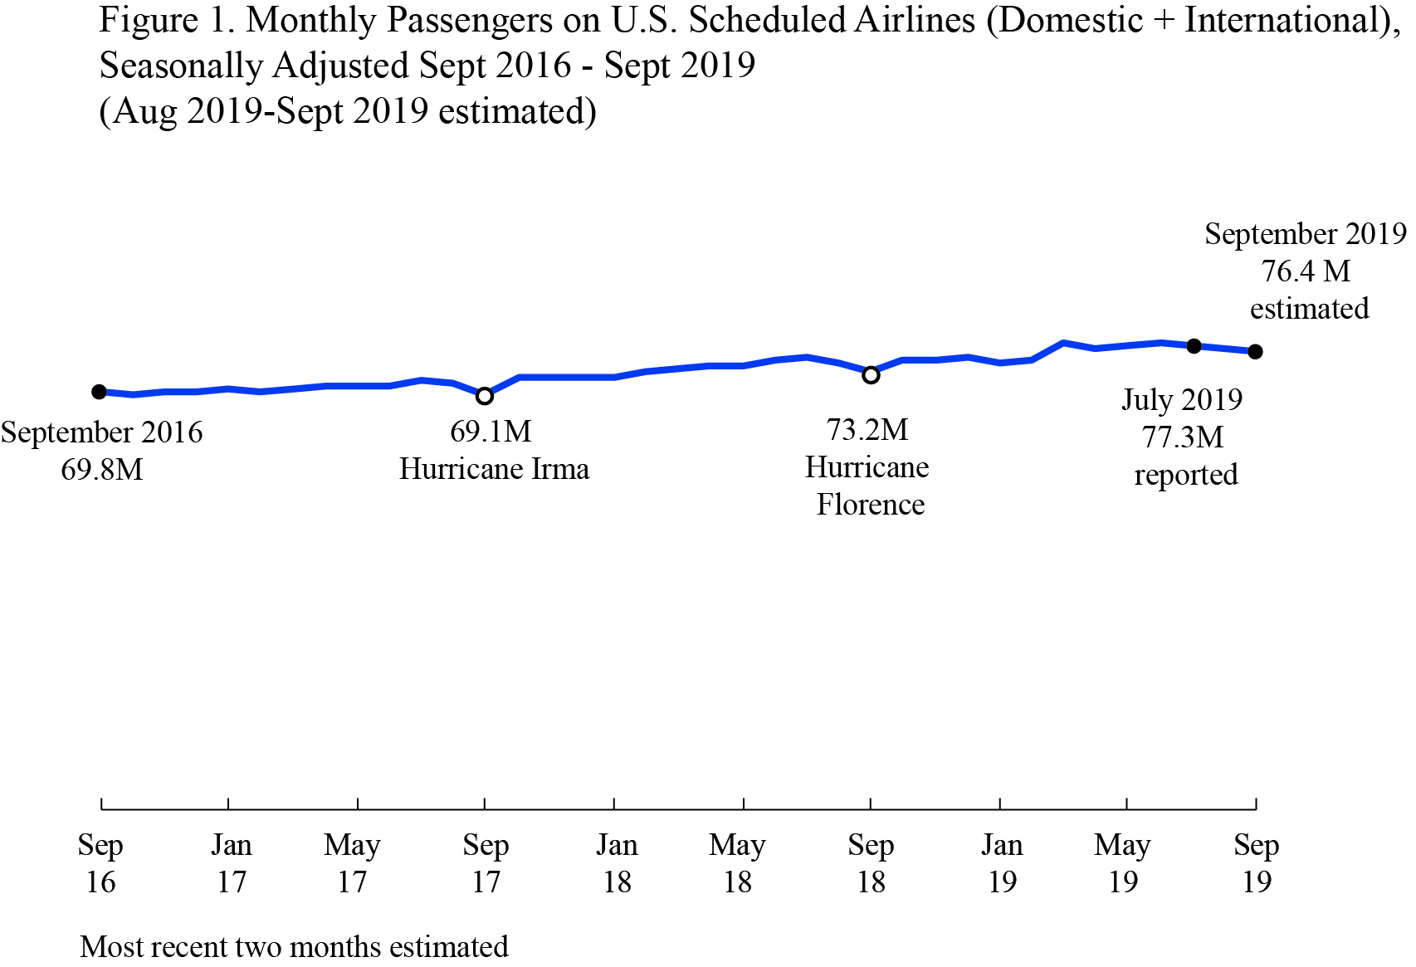
Introduction
The growth in air traffic passengers demand is steadily increasing every year. This is an opportunity for airline companies to grow and generate more revenues.
Approximately 70M passengers monthly are flaying on US airlines.
In this analysis two data sets will be used:
Twitter US Airline Sentiment (Feb 2015) (14.5k tweets)
Self Scrapped data from tweeter (Dec 2019) (4k tweets)

Slide 4

Project Objectives
Analyze the reasons of high number and percentage of negative tweets for American airline compare to competitors
Build tweets sentiment prediction model to use for future periodic analysis
Tweets segmentation using clustering to further understand the types of tweets

Slide 5



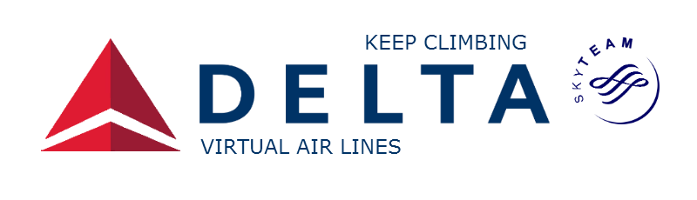

Data
Twitter US Airline Sentiment (Feb 2015):
14,640 tweets for 6 major US airlines were scrapped and sentiment labeled.
Used Variables (airline sentiment, negative reason, name of the airline, and the text of the tweet)
All other columns were dropped from the data frame. 400 tweets were duplicated and removed from the dataset.

Slide 6
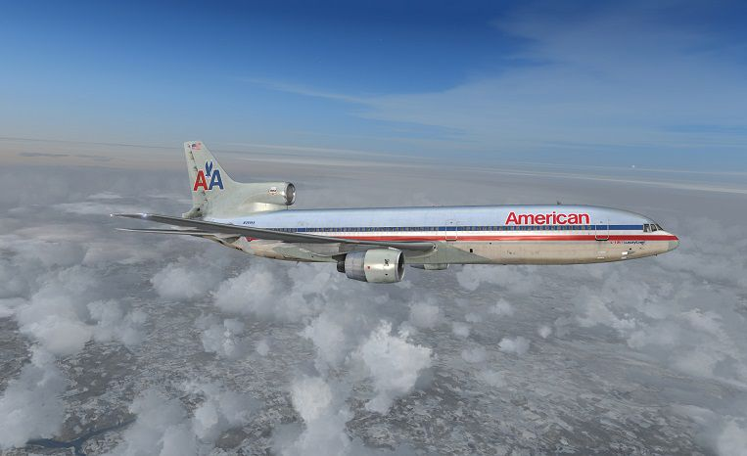
Data
Self Scrapped Data (Dec 2015):
4,000 tweets for American Airlines were scrapped using tweeter api, and sentiment labeled using Sentiment Intensity Analyzer from nltk vader library.
This data frame has two variables only (text and sentiment)

Slide 7
Text Variables
For both data frames text variables were created to be used in the perdition model, these variables are:
count_words
count_mentions
count_hashtags
count_capital_words
count_excl_quest_marks
count_emojis

Slide 8
Text Cleaning
Both data frames tweets text where cleaned by :
Removing all mentions (@)
Removing all the hash tags (#) but not the actual tag
Set all words to lowercase
Remove all punctuations
Remove all digits
Remove stopwords

Slide 9
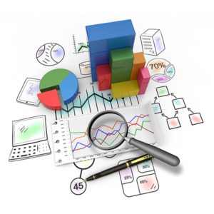
Data Exploration
Percentage of Tweets for each Airline.
Tweets Sentiment Distribution.
Overall
Per Airline
Reason for negative Tweets:
Overall
American Airlines (American + US Airways)
Other Airlines
Most repeated Words in Negative Tweets:
Overall
American Airlines
Text Features Distribution

Slide 10
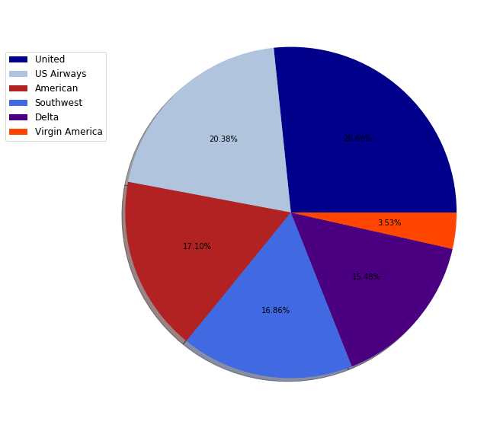
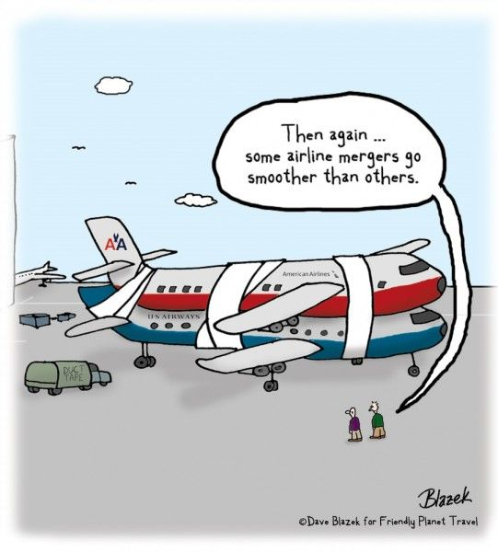
Percentage of Tweets for each Airline
Virgin America has the least representation
tweets are almost balanced distributed between the other 5 airlines.
If we consider US Airways as part of the American, then they represent more than 1/3 of the tweets.

Slide 11
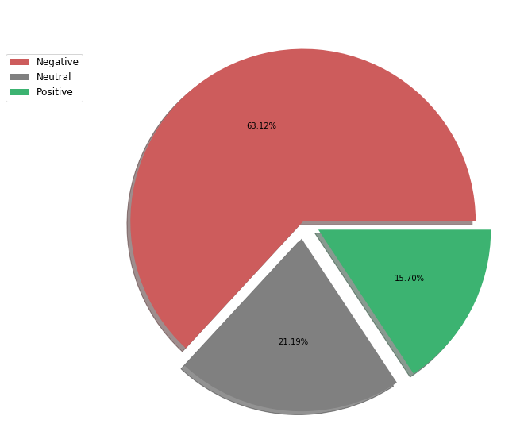
Tweets Sentiment Distribution (Overall)
Almost 2/3 of the tweets were negative

Slide 12
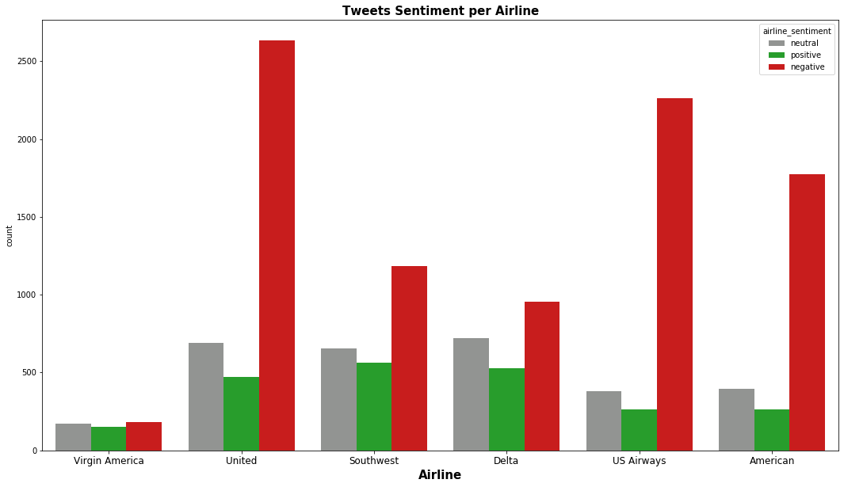
Tweets Sentiment Distribution (Overall)

Slide 13
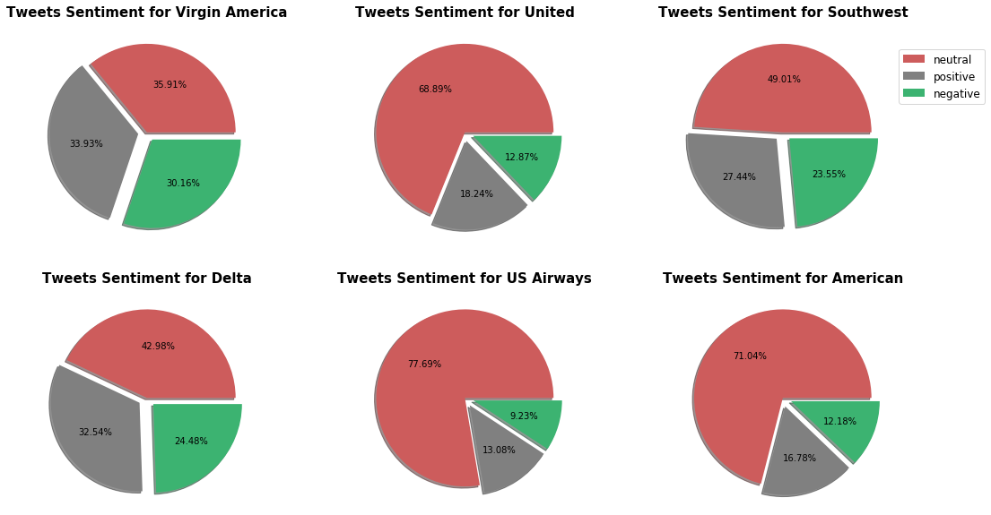
Tweets Sentiment Distribution (Overall)

Slide 14
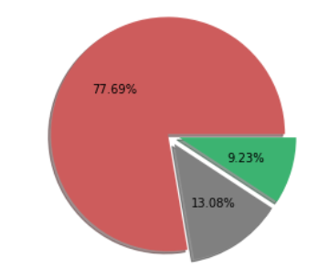
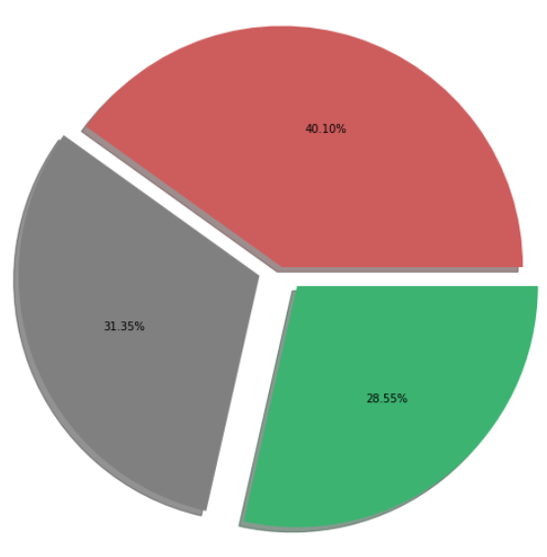
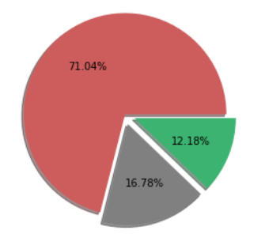
Tweets Sentiment Distribution (American)
2015
2019
In 2015, more than 70% of the tweets were negative.
in 2019, only 40% of the tweets were negative
US Airways
American

Slide 15
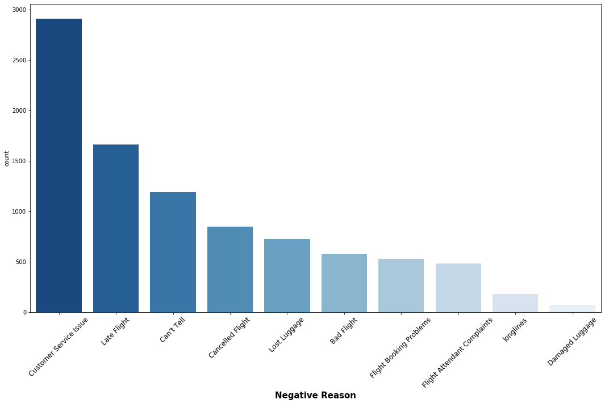
Reasons for negative Tweets (Overall)

Slide 16
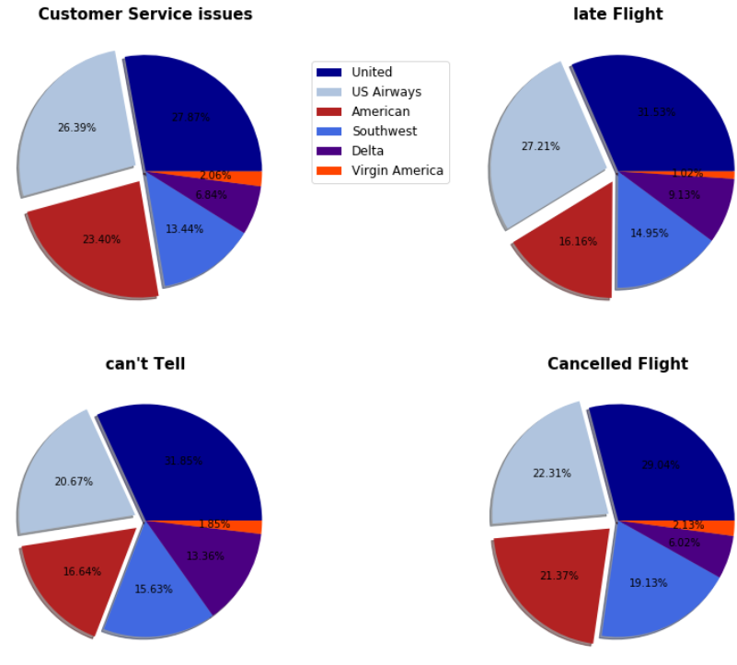
Reasons for negative Tweets (Overall)

Slide 17
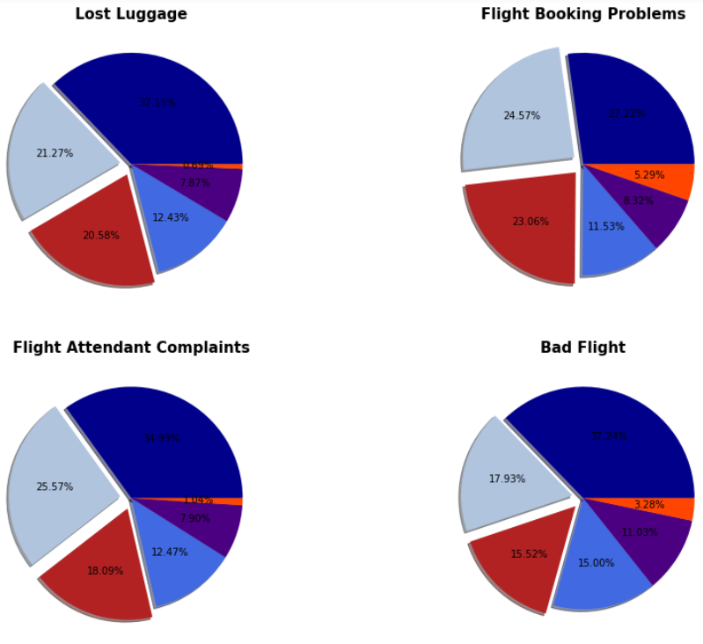
Reasons for negative Tweets (Overall)

Slide 18
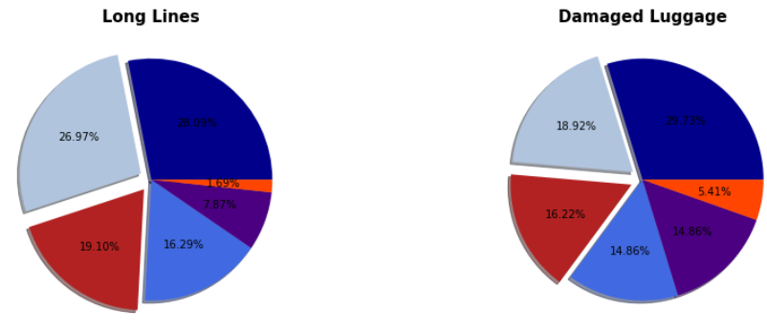
Reasons for negative Tweets (Overall)

Slide 19
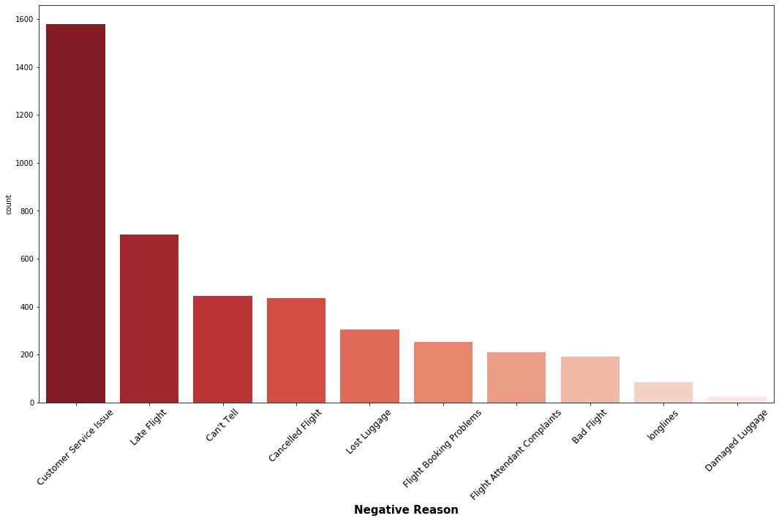
Reasons for negative Tweets (American)

Slide 20
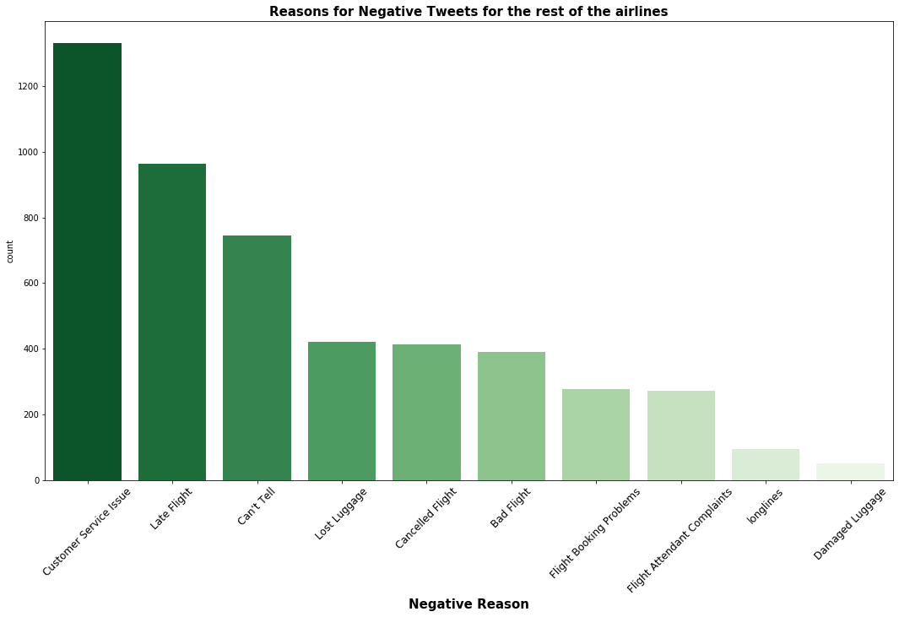
Reasons for negative Tweets (Others)

Slide 21
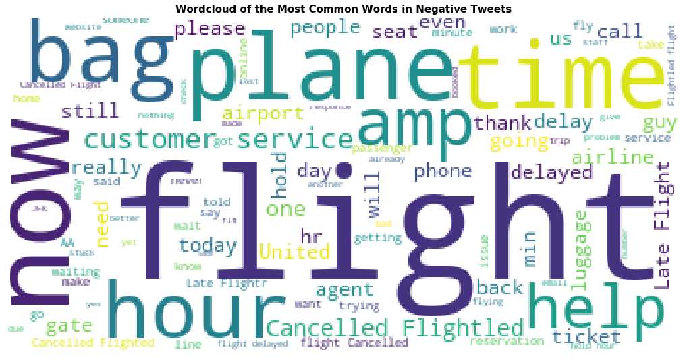
Most Repeated Words in Negative Tweets (Overall)

Slide 22
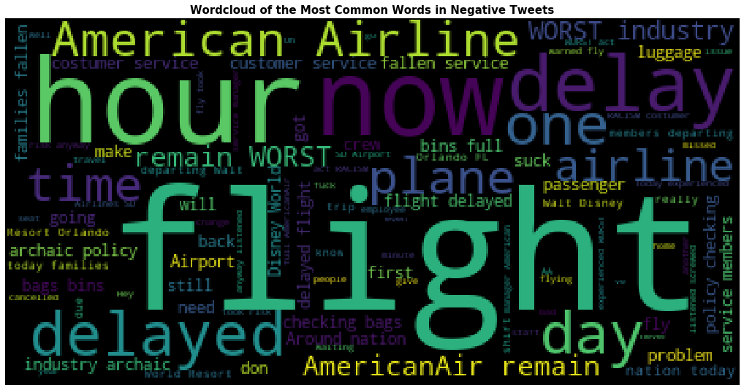
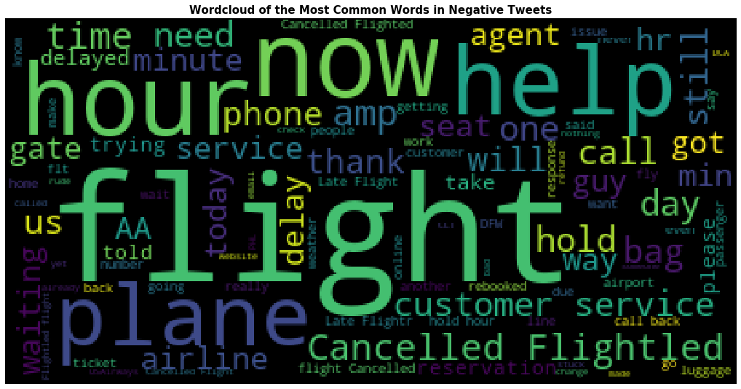
Most Repeated Words in Negative Tweets (American)
2019
2015

Slide 23
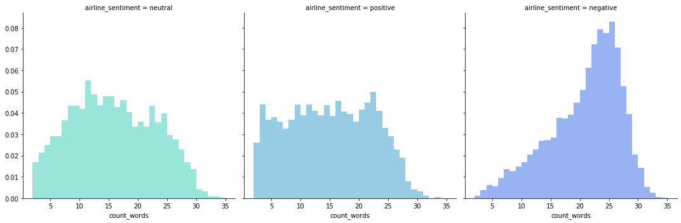
Text Features Distribution(count_words)

Slide 24
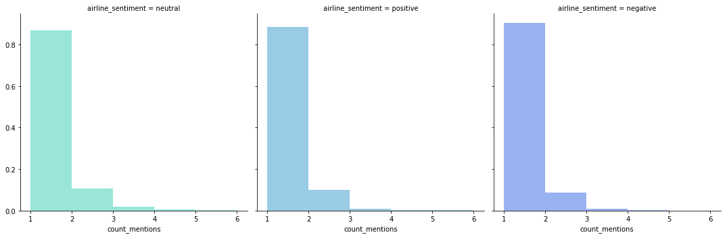
Text Features Distribution(count_mentions)

Slide 25
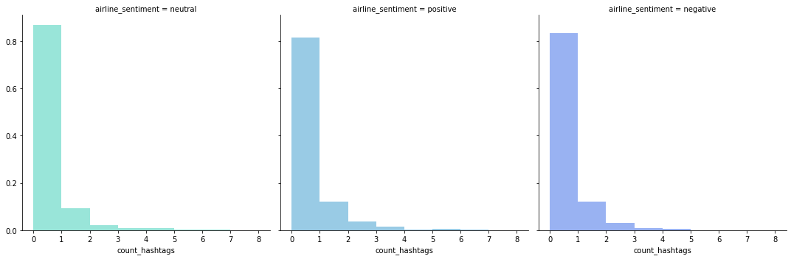
Text Features Distribution(count_hashtags)

Slide 26
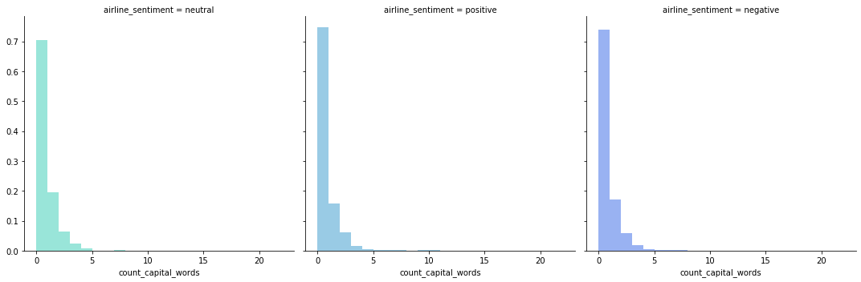
Text Features Distribution(count_capital_words)

Slide 27
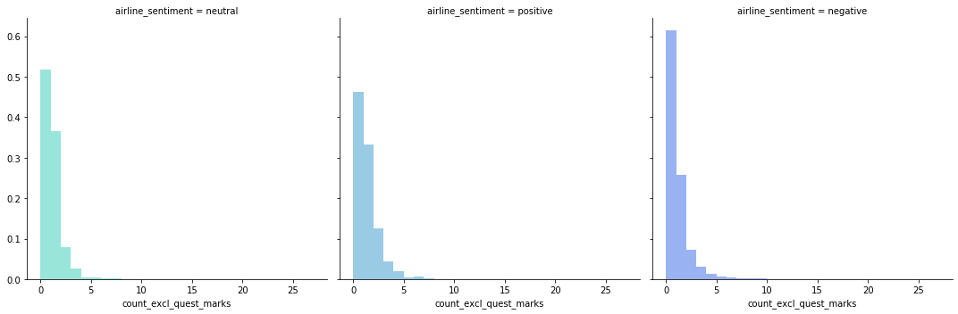
Text Features Distribution(count_excl_quest_marks)

Slide 28
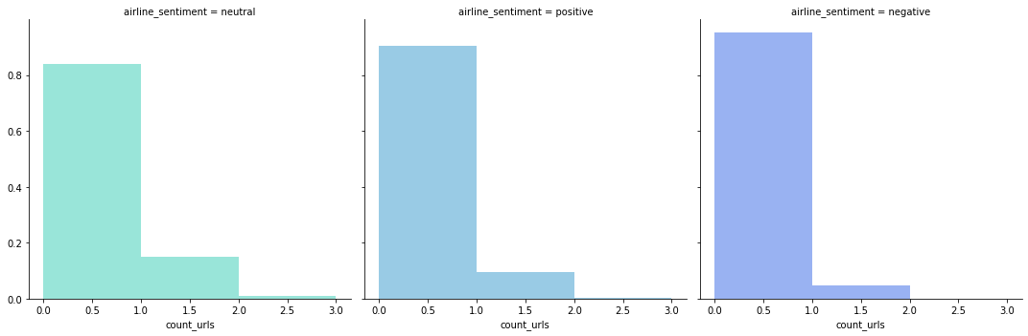
Text Features Distribution(count_urls)

Slide 29
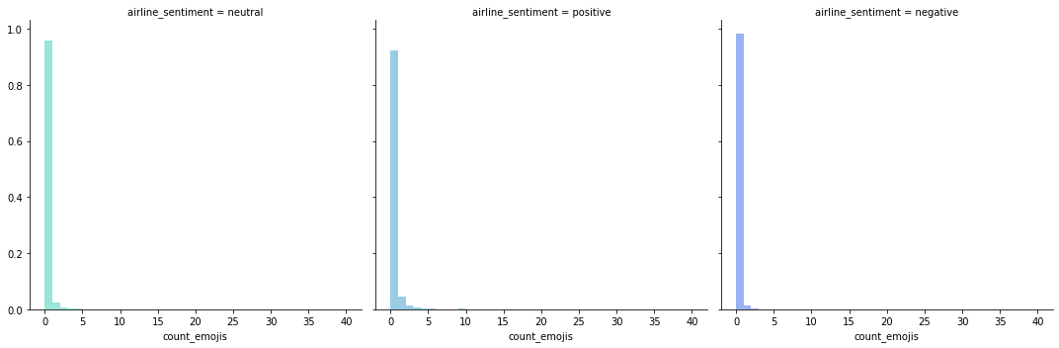
Text Features Distribution(count_emojis)

Slide 30

Prediction Model
Counter Vectorizer and Tf-idf will be compared together with 3 supervised learning classifiers (Multinomial Naïve Bayes, Logistic Regression, and Random Forest Classifier).
Grid search with 5-folds cross validation will be used to find the best combination and best parameters for the classifiers.

Slide 31
Prediction Model Selection
Model | Accuracy (Best Cross-Validation) | Precision | Recall | F1-Score
cv , mnb | 0.775 | 0.77 | 0.78 | 0.77
cv, logreg | 0.792 | 0.80 | 0.80 | 0.80
cv, rfc | 0.746 | 0.73 | 0.75 | 0.73
tf-idf, mnb | 0.746 | 0.75 | 0.76 | 0.74
tf-idf, logreg | 0.780 | 0.79 | 0.80 | 0.79
tf-idf, rfc | 0.744 | 0.74 | 0.75 | 0.73

Slide 32
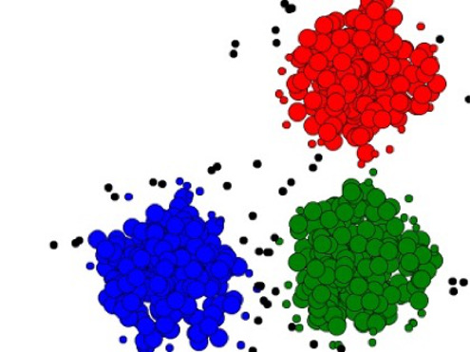
Clustering Model
Clustering of American Airline tweets in 2015, and 2019 has been performed
K-Means and Affinity Propagation models were evaluated. The model with best combination of number of clusters and silhouette score has been selected

Slide 33
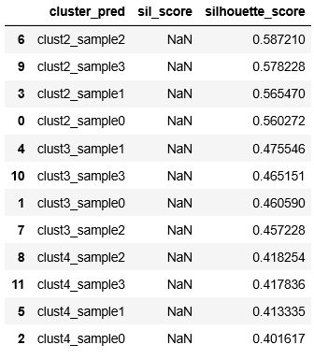
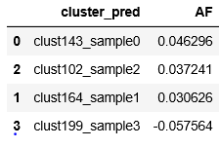
Clustering Model Selection (2015)
Affinity Propagation
K-Means
Best Model is K-Means with 2 clusters
cluster_0 =

Slide 34
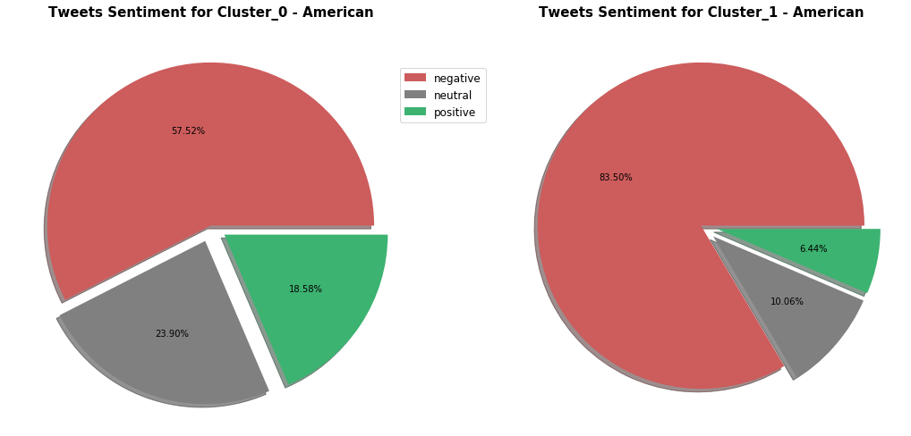
American Airline tweets Clustering (2015)

Slide 35
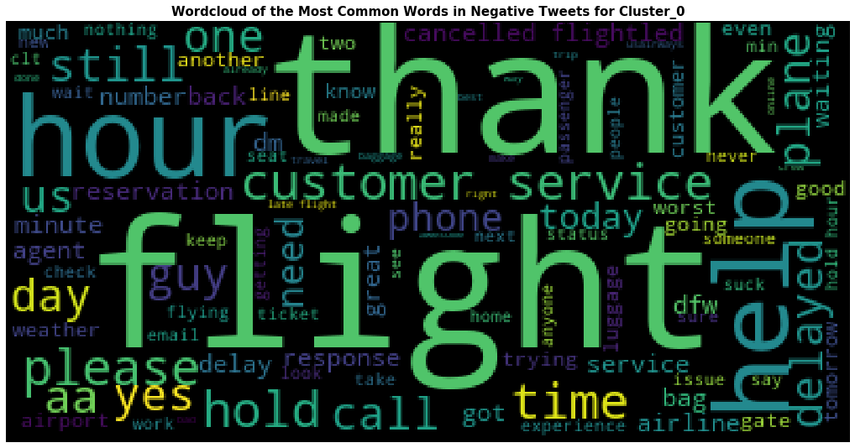
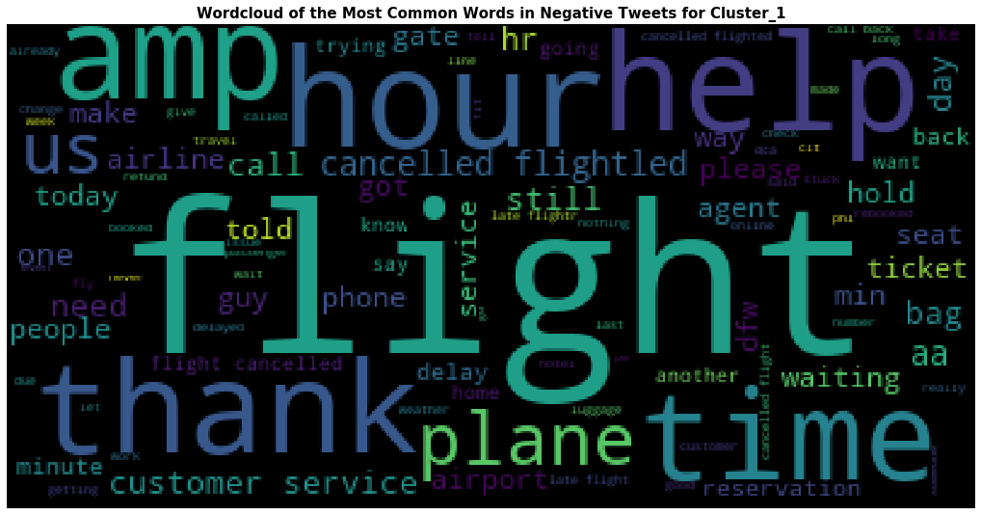
American Airline tweets Clustering (2015)
Cluster_0
Cluster_1

Slide 36
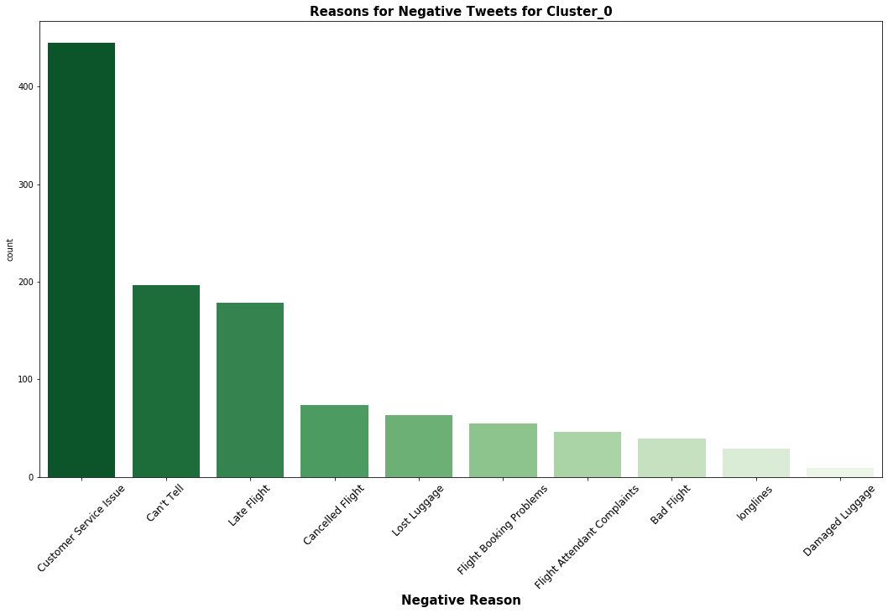
Reasons for Negative Tweets (Cluster_0)

Slide 37
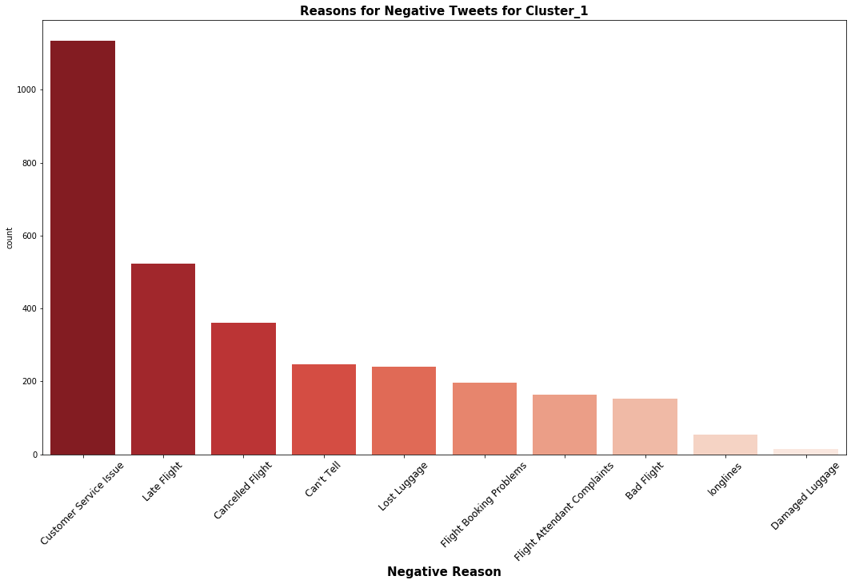
Reasons for Negative Tweets (Cluster_1)

Slide 38
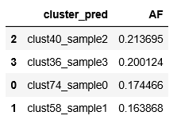
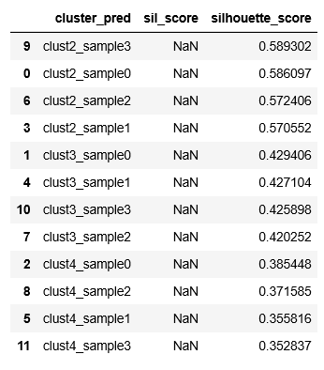
Clustering Model Selection (2019)
Affinity Propagation
K-Means
Best Model is K-Means with 2 clusters
Cluster_0 = 2819
Cluster_1 = 1181

Slide 39
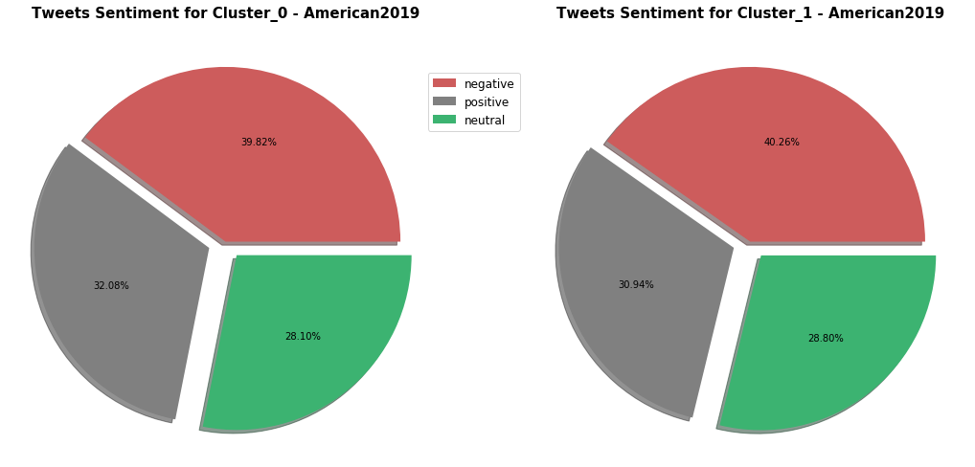
American Airline tweets Clustering (2019)

Slide 40
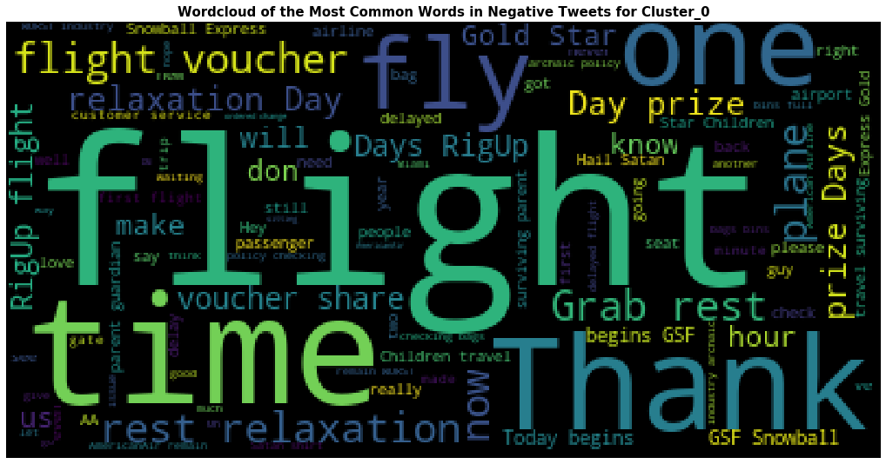
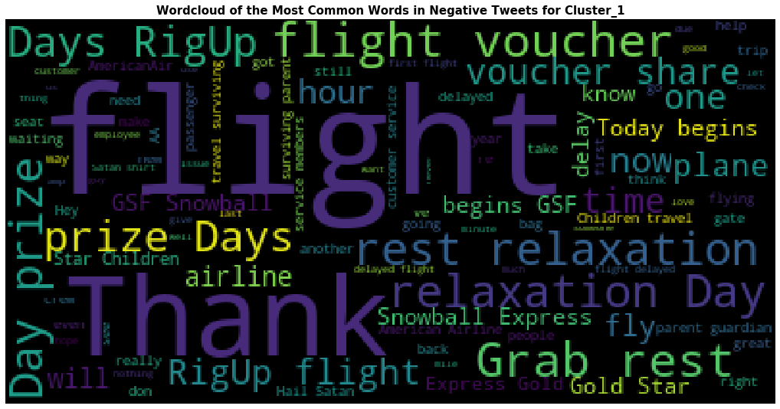
American Airline tweets Clustering (2019)
Cluster_0
Cluster_1

Slide 41
Conclusion & Recommendations
Analysis
Almost 50% of the customer service-related tweets were addressing American.
The more frustrated American airlines passengers were frustrated due to issues related to late and cancelled flights. Together with a poor customer service this resulted in escalated negative tweets on the airline.
It is not possible to control all flights delay and cancellation, but it can be minimized by more efficient planning and management. When flight are cancelled or delayed, American should provide a good customer service to use this setback as an opportunity of turning negative thoughts to positive ones.

Slide 42
Conclusion & Recommendations
Prediction Model
A model using Count Vectorizer and Logistic Regression Classifier managed to predict the sentiment of the tweets with an accuracy prediction close to %80. This model can be used periodically to assess customer satisfaction and monitor progress.
The model was tested on 2019 data and received an accuracy of 99.30%.
2019 Tweets sentiments were more balanced and showed improvement in customer service.

Slide 43
Conclusion & Recommendations
Clustering Model
2015 data was easier to define the difference between the clusters, the first group of customers are balanced, there is a relatively high proportion of negative tweets with no clear reason, and less cancelled and late flights issues. The second group represents the frustrated customers tweets (83%), those customers are frustrated mainly due to customer service and flights schedule issues.
2019 data was harder to define the difference between the clusters. Both clusters are balanced with slight difference between them. The first group represents tweets related to time and scheduling issues, tweets are slightly negative to the rest of the tweets. the second group represents tweets related to exhausting and vouchers. It might be related to issues passengers raised looking for compensation in terms of flight vouchers.

Slide 44
Weak Points and Shortcomings
The size of the data is relatively small for tweets with limited number of words per tweet. The size of the data should be in hundred thousands or millions to achieve better result.
The sentiment labeling of the data need to be improved. providing more key words and build aviation related sentiment labeling will improve the performance. Deep learning could be a way for more improvement.
Competitors data should be collected as well in the year 2019. This can help in identifying how American is doing compare to competitors as the case for year 2015, but due to time constraints I could not do it.
The tweets were collected in specific limited period (week or two from a specific year and month), this can not be generalized on the whole satisfaction of the customers, larger period span is advised.

Slide 45
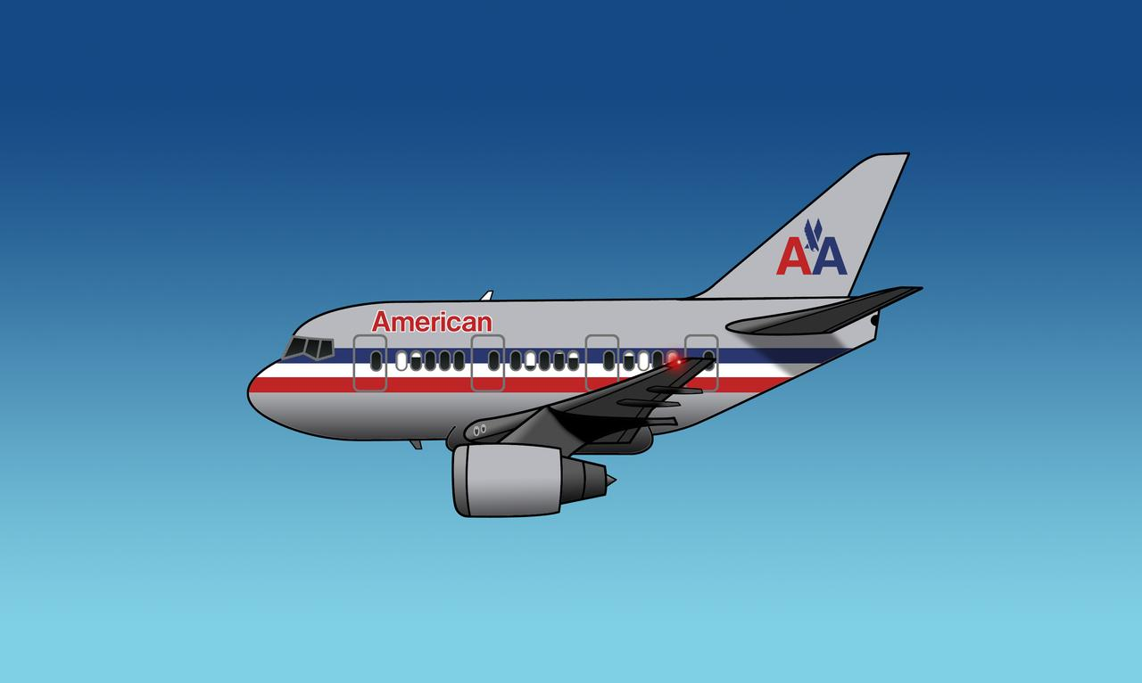
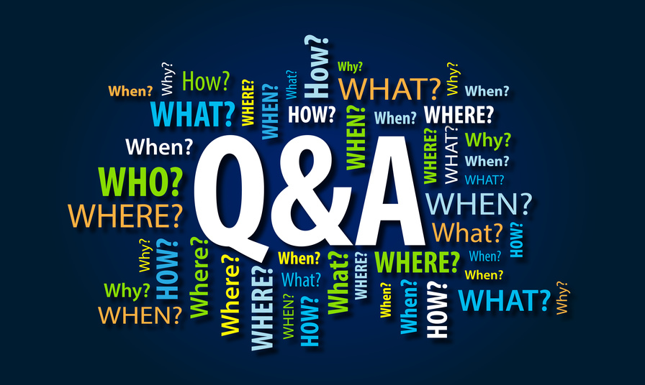

Slide 46
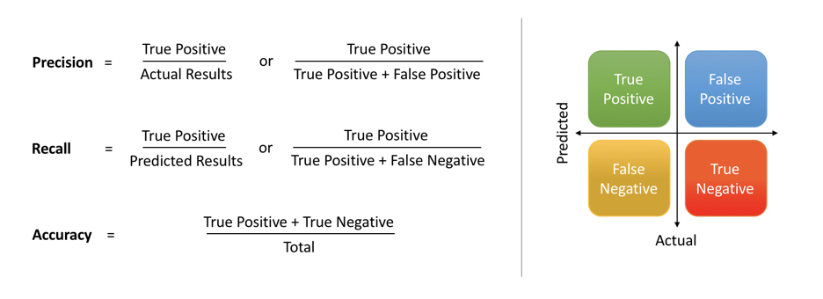
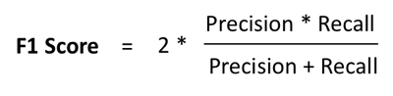
Extra: Metrics for Model Selection

